Slide 1

Unit 2

Slide 2
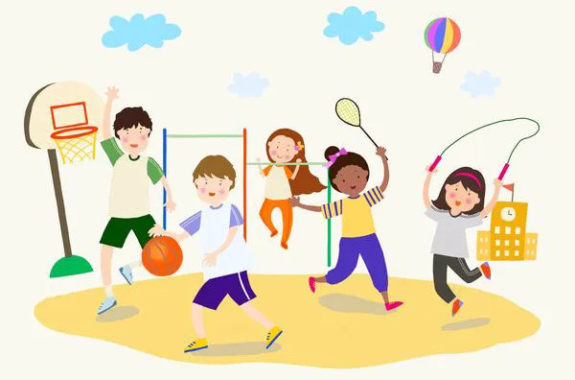
Unit 2
How often do you exercise?

Slide 3
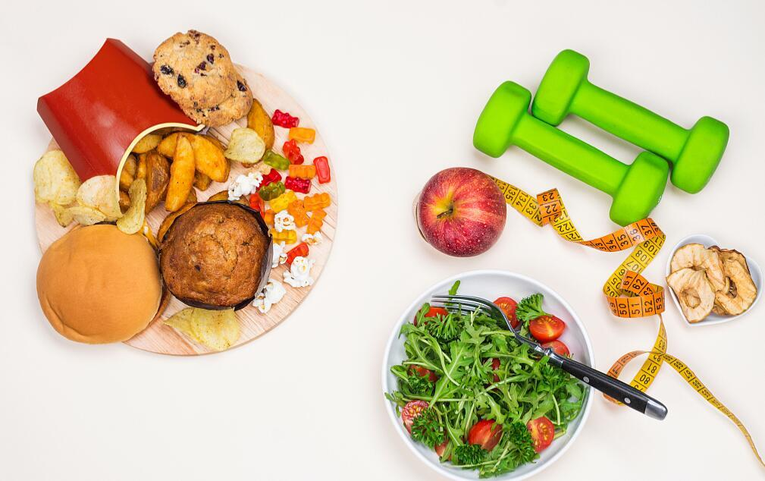


Slide 4
Writing

Slide 5


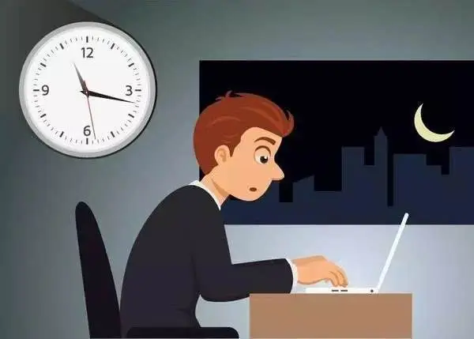
Topic: daily habits
Write a report about your good and bad habits.
Say how often you do things.
时态：一般现在时
人称：第一人称

Slide 6
daily habits(频率副词)
eating habits
routine(生活作息)
fun(娱乐)
study
others

Slide 7


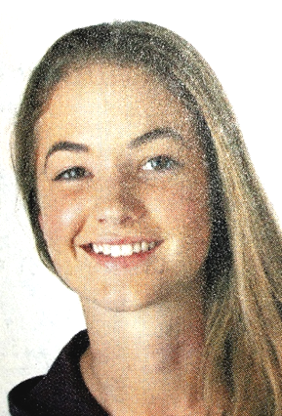
Jane’s daily habits
According to the days of doing an activity, use a frequency word to describe it.
Activities | Days a year
Exercise Read books Watch TV for over 2 hours Drink juice Eat hamburgers Help with housework Stay up late Go to the dentist | 365 365 320 210 95 20 15 0
every day/always
every day/always
usually
often
sometimes
hardly ever
hardly ever
never

Slide 8
Jane’s daily habits
Look at the information in the chart and complete the report.
Jane is a 16-year-old high school student in the United States. American Teenager magazine asked her about her habits. Jane has a lot of good habits. She always exercises and she reads books __________. Also, she ________ drinks juice and she ____________ stays up late. However, she has some bad habits, too. She _________ watches TV for more than two hours a day, and she __________ eats hamburgers. Her parents are not very happy because she ___________ helps with housework and she __________ goes to the dentist for teeth cleaning. She says she is afraid!
every day
often
hardly ever
usually
sometimes
hardly ever
never
Beginning
引出话题
Body
日常习惯

Slide 9
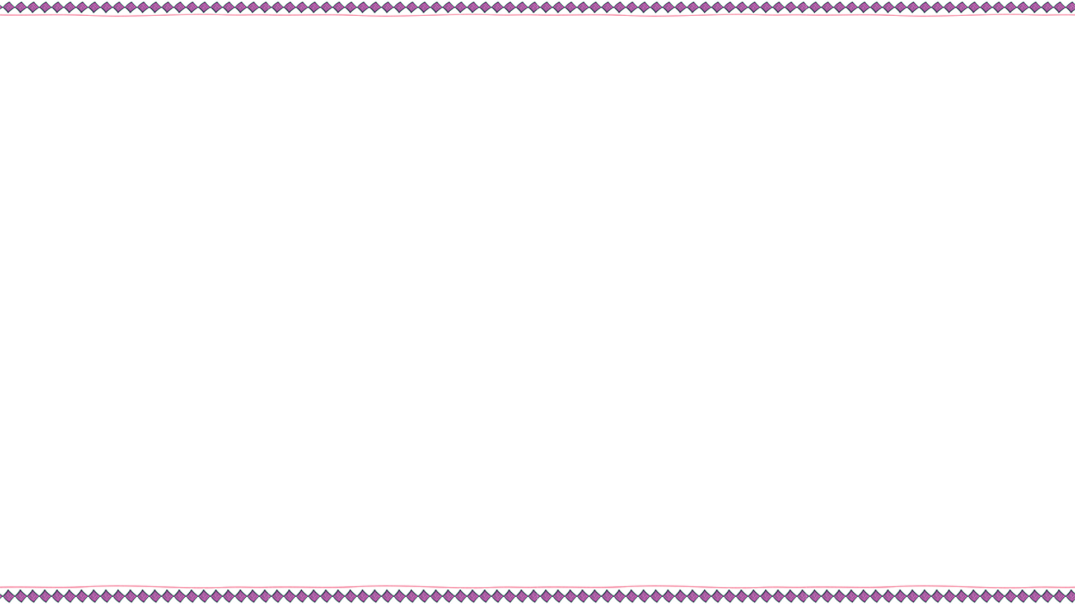

Complete the chart with your own information.
【谋篇布局】
引出话题
I am a middle school student. I want to tell you about some of my habits here.
介绍“我”的好习惯
I have a lot of good habits.
 | Activities | How often?
Good habits
Exercise
Read books
Eat fruit/vegetables
Drink milk/juice
Stay up late
every day
always
every day
every day
never

Slide 10
介绍“我”的坏习惯
However, I have some bad habits, too.
 | Activities | How often
Bad habits
Watch TV for over 2 hours
Use the Internet
Eat hamburgers
Help with housework
See/Go to the dentist
always
twice a day
often
hardly ever
never
结尾
Old habits die hard, so start changing(改变) before it’s too late. As for(至于) my good habits, I will try to keep them.

Slide 11
【范文】
引出话题
I am a middle school student. I want to tell you about some of my habits here.
介绍“我”的好习惯及理由
I have some good habits. I like playing sports, so I play basketball almost every day after school. I never stay up late because it's not good for my health. What's more, I take notes carefully in class. I think it can help me remember everything
the teacher says.

Slide 12
介绍“我”的坏习惯及改正决心
However, I have some bad habits, too. I hardly ever eat fruit. I know an apple a day keeps the doctor away, so I am going to eat more fruit from now on. Also, I often watch TV after dinner and sometimes I almost forget to do my homework.
结尾
Old habits die hard, so start changing(改变) before it’s too late. As for(至于) my good habits, I will try to keep them.

Slide 13

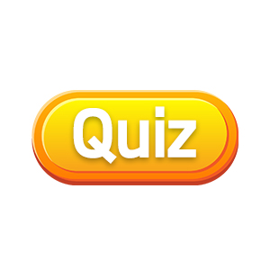
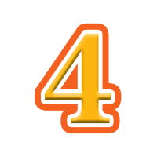
Take the health quiz. Compare your results with your partner’s. Who’s healthier?
adv. 几乎;差不多
1. How often do you eat breakfast?
a. Never. b. A few times a week c. Almost every day.
2. How often do you eat fast food?
a. Never. b. A few times a week c. Almost every day.
3. How often do you eat vegetables and fruit?
a. Never. b. A few times a week c. Almost every day.
1. a=0, b=1, c=2
2. a=2, b=1, c=0
3. a=0, b=1, c=2

Slide 14
4. How often do you exercise?
a. A few times a year. b. A few times a month.
c. A few times a week.
5. How many hours do you watch TV every week?
a. None. b. One to four. c. Five or more.
6. How many hours do you usually sleep at night?
a. Less than six. b. Six or seven. c. Eight or more.
pron. 没有一个; 毫无
less than 少于
4. a=0, b=1, c=2
5. a=2, b=1, c=0
6. a=0, b=1, c=2

Slide 15
n. 得分; 点 v. 指; 指向
9-12 points: You’re really healthy!
Good for you and your health!
4-8 points: You’re smart about your health
most of the time.
0-3 points: You have to learn more about
healthy habits.
Don’t worry — you can do it!
1. a=0, b=1, c=2
2. a=2, b=1, c=0
3. a=0, b=1, c=2
4. a=0, b=1, c=2
5. a=2, b=1, c=0
6. a=0, b=1, c=2

Slide 16


3. Fill in the blanks in the conversation.
usually
A: What do Tom and Mike __________ do on weekends?
B: They sometimes go to the museum.
A: __________ do they go to the shopping center?
B: __________ ever. Maybe about twice a month.
How often
Hardly
A: ___________ do they watch TV?
B: Mike never watches TV, but Tom watches TV _________ day.
A: Oh, I’m just like Tom. I _________ watch TV, too.
How often
every
always

Slide 17
1. Complete the chart with activities you do and don’t do. What about your mother/father?
 | I | My mother/father
always
usually
often
sometimes
hardly ever
never
play basketball
play chess
read books
read newspapers
eat hamburgers
eat chicken
drink juice
drink tea
watch TV
use the Internet
stay up late
stay up late

Slide 18
2. Write five sentences using the information above.
1. I always play basketball after school.
2. My father always plays chess on weekends.
3. I usually read books on weekends.
4. My father sometimes drinks tea.
5. I hardly ever watch TV.
6. My father never stays up late.

Slide 19


Slide 21

The survey(调查) about Tina’s and Bill’s habits.
Questions Tina(girl) Bill(boy)
1. How often do you exercise? __________ __________ 2. How often do you eat fruit? __________ __________ 3. How many hours do you sleep every night? __________ __________ 4. How often do you drink milk? __________ __________ 5. How often do you eat junk food? __________ _________ 6. How often do you drink coffee? __________ __________
every day
hardly ever
every day
never
nine
nine
every day
never
2 or 3 times a week
3 or 4 times a week
never
4 times a day

Slide 22
Tina’s Good/Healthy Habits
I think Tina has good habits, because she exercises and eats fruit every day. She sleeps nine hours every night. And she likes milk very much,so she drinks milk every day. She eats junk food 2 or 3 times a week, but she never drinks coffee. So she is very healthy and her lifestyle(生活方式) is good.

Slide 23
Jane’s daily habits
Look at the information in the chart
and complete the report.
Jane is a 16-year-old high school student in the United States. American Teenager magazine asked her about her habits. Jane has a lot of good habits. She always exercises and she reads books __________. Also, she ________ drinks juice and she ____________ stays up late.
Activities | Days a year
Exercise Read books Watch TV for over 2 hours Drink juice Eat hamburgers Help with housework Stay up late Go to the dentist | 365 365 320 210 95 20 15 0
every day
often
hardly ever

Slide 24
Look at the information in the chart
and complete the chart.
However, she has some bad habits, too. She _________ watches TV for more than two hours a day, and she __________ eats hamburgers. Her parents are not very happy because she ___________ helps with housework and she __________ goes to the dentist for teeth cleaning. She says she is afraid!
Activities | Days a year
Exercise Read books Watch TV for over 2 hours Drink juice Eat hamburgers Help with housework Stay up late Go to the dentist | 365 365 320 210 95 20 15 0
usually
sometimes
hardly ever
never

Slide 25



but和however
从语义上看，but所表示的是非常明显的对比，转折的意味较however要强。
从语法上看，but是个并列连词，其连接的并列成分可以是单词、短语或句子。however表示“然而”、“可是”时，是连接性副词。
从语序上看，but总是位于它所引出的分句之首，而however却可位于分句之首、之中或之尾。
从标点上看，but之后一般不使用逗号，但however通常用逗号与句子其他部分分开。

Slide 26

1. However, she has some bad habits, too.
然而，她也有一些坏习惯。
however adv. 然而; 不过
表示转折关系，可放在句首、句中、句末，常用逗号与句子其他部分隔开。
e.g. This is one way to solve the problem. However, there are others.
Jenny felt ill yesterday. She went to work, however.
There may, however, be other things we don’t know about.

Slide 27
【语境应用】根据句意选用but或however填空。
1) The boy is hard-working, _______ not very clever.
2) I thought my answer was right. _________, Miss Wang said I was wrong.
3) Henry doesn’t like classical music ________ his sister enjoys it very much.
4) I’d like to go with you. I’m too busy, _________. I’m afraid I’ll have no time.
but
However
but
however

Slide 28
2. She usually watches TV for more than two hours a day.
她通常每天看电视超过两个小时。
more than 超过……; 多于……
后接数词，同义表达为over，反义表达为 less than (不到；少于)。
more than后接名词, 意为 “不只是；不仅仅”。
e.g. There are more than 30 students on the playground.
Mr. Li is more than an actor. He is a teacher, too.

Slide 29
【语境应用】Ⅰ. 写出划线部分的汉语意思。
1) John lived in China for more than five years.
______________
2) He is more than a teacher to us. He is our friend, too.
___________________________
Ⅱ. 同义句转换。
3) It took Jason over 30 minutes to get to school this morning.
It took Jason _______ _______ 30 minutes to get to school this morning.
五年多
对我们来说，他不仅仅是老师
more than

Slide 30


体裁：介绍自己的好习惯和坏习惯
文体：说明文
时态：介绍日常习惯时，用一般现在时。
人称：第一人称

Slide 31
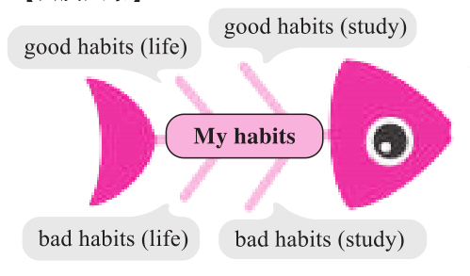
【头脑风暴】

Slide 32

【提供素材】
语块
习惯（生活、学习） | 具体内容 | 频率
好习惯 | ▲exercise / play sports, go running / do some running, (1)_____________________ (帮助做家务), drink water / juice instead of (而不是) cola or drinks, eat fruit and vegetables instead of junk food, (2)________________(去看牙医), brush teeth, | (almost) every day, once / twice a week / month, three / four / ... times a week, (3)_____________(几乎从不), never, always, usually, often, sometime
help with housework
hardly ever
go to the dentist

Slide 33
习惯 （生活、学习） | 具体内容 | 频率
好习惯 | (4)___________________ ____________(早睡早起), wash your hands before and after a meal, throw waste in the bin (把废物扔进垃圾桶), keep the house clean, keep your desk tidy, get enough sleep and rest | (almost) every day, once / twice a week / month, three / four / ... times a week, hardly ever, never, always, usually, often, sometime
get up early and go to
bed early

Slide 34
习惯 （生活、学习） | 具体内容 | 频率
好习惯 | ▲go to the library to read, plan (计划) your time wisely (明智地), take notes (做笔记), (5)______________________ (按时完成作业), listen to the teacher carefully (认真地), review (复习) your notes after class, bring your homework to school, ask the teacher questions | (almost) every day, once / twice a week / month, three / four / ... times a week, hardly ever, never, always, usually, often, sometime
finish homework on time

Slide 35
习惯（生活、学习） | 具体内容 | 频率
坏习惯 | ▲本身对健康有害 (6)____________(熬夜), eat junk food or fast food, play games on your mobile phone in bed, read in moving cars, don't finish homework on time, don't listen in class ▲由于频率高而对自己不利 watch TV, eat candy, (7)______________(使用互联网), play computer games, eat hamburgers | all day, always, often, every day, (8)_____________ ____________(三个多小时)
stay up late
more than/over
three hours
use the Internet

Slide 36
句型
I have some good / bad habits such as ...
It's good for my health.
I hardly ever / often / never ...
I … three times / ... a week.
It's not easy to give up (放弃) bad habits.
As the saying goes, never leave today's work until tomorrow.
The early bird catches the worm (早起的鸟儿有虫吃).
It's never too late to learn.
An apple a day keeps the doctor away.

Slide 37
none & no one
【观察】请观察下面的例子，思考none和no one有什么不同，然后补全结论部分所缺的内容。
(1) —How many dogs can you see?
—None.
(2) None of my children has / have blonde hair.
(3) —How much time did you spend there yesterday?
—None.
(4) —Who likes to join the chess club?
—No one.

Slide 38
(5) No one wants to die.
(6) None of this money is mine.
【结论】
(1) none和no one都有“一个也没有”的意思。
(2) _______ 既可以指人，也可以指物。可单独使用，也可以和of连用，后跟可数名词复数或不可数名词。作主语时，谓语动词可用单数也可用复数。
(3) _______只能指人，不能指物。一般单独使用，不和of连用。作主语时，谓语动词用_______数。
(4) _______可用于回答how many / how much开头的提问，而_______则回答who开头的提问。
none
no one
单
none
no one

Slide 39
【语境应用】根据语境选择恰当的选项填空。
1) —How many cakes are there in the fridge?
—________ (None / No one).
2) ________ (None / No one) of us went to the meeting yesterday.
3) —Who was late today?
—________ (None / No one).
None
None
No one

Slide 40


I. 根据语境及所给首字母提示或汉语提示，补全所缺单词。
1. I have a toothache (牙痛). I have to go to the d_______.
2. There are three dictionaries, but n_____ of them is mine.
3. David writes short stories for some __________(杂志).
4. They won (赢) the game by five ________(得分) to three.
dentist
none
magazines
points
5. I like this model car. _________(然而), I don't have money to buy it.
6. ________(几乎) everything was lost in the fire.
However
Almost

Slide 41
II. 根据短文内容, 从方框中选择恰当的单词填空, 注意形式变化。
twice, however, healthy, almost, little, magazine, Internet, housework, although, together
David, a 15-year-old boy from England, lives in Shanghai with his parents now. He is very healthy. (1)_________, he had some bad habits in the past. He liked to stay up late and he usually played computer games on the (2)_________ for five hours at night. In the morning, he got up late and didn’t eat breakfast. For lunch and dinner, he ate junk food.
However
Internet

Slide 42
twice, however, healthy, almost, little, magazine, Internet, housework, although, together
He liked eating candies very much and he (3)_______ ate them every day. And he hardly ever exercised. (4)_________ his parents asked him to do sports, he never listened.
Last year, David often felt tired. His parents were worried about his (5)________, so they took him to the hospital. The doctor (医生) told David that he was in poor health (健康欠佳). Then David decided to do something. “I’ll try to spend (6)_______ time on the computer,” he said.
almost
Although
health
less

Slide 43
twice, however, healthy, almost, little, magazine, Internet, housework, although, together
“I’ll try to eat healthy food. And I’ll get up early and exercise at least (7)_______ a week. Besides, I will do the housework with my parents (8)_________.”
Now he loves doing sports. After dinner, he often helps his parents with the (9)___________. On weekends, he hardly ever plays computer games. He also loves reading some English (10)__________ such as Time in his free time. These good habits help him keep healthy.
twice
together
housework
magazines

Slide 44


1. Finish your report in 3c.
2. Do a survey in your family, using the questions and charts in Part 4.

Slide 46

What information can you find in the chart?
Is the information about the girl? What’s her name?
What does the heading “Days a year” mean?
What good habits does the girl have?
Does the girl have any bad habits? What are they?

Slide 47


Complete the report.
Jane is a 16-year-old high school student in the United States. American Teenager magazine asked her about her habits. Jane has a lot of good habits. She always exercises and she reads books __________. Also, she ________ drinks juice and she ____________ stays up late.
n. 杂志; 期刊
every day
often
hardly ever

Slide 48
prep. & conj. (用于引出比较的第二部分) 比
more than 多于
adv. 然而; 不过
usually
However, she has some bad habits, too. She _________ watches TV for more than two hours a day, and she __________ eats hamburgers. Her parents are not very happy because she ___________ helps with housework and she __________ goes to the dentist for teeth cleaning. She says she is afraid!
sometimes
hardly ever
never

Slide 49

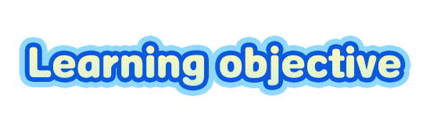
To learn to use adverbs of frequency to write about habits

Slide 50

Talk about your good habits and bad habits.
Complete the chart with your own information. In the last column, use expressions like always, every day, twice a week and never.
 | Activities | How often?
Good habits
Exercise
Read books
Eat fruit
Drink milk
Stay up late
every day
always
every day
every day
never

Slide 51

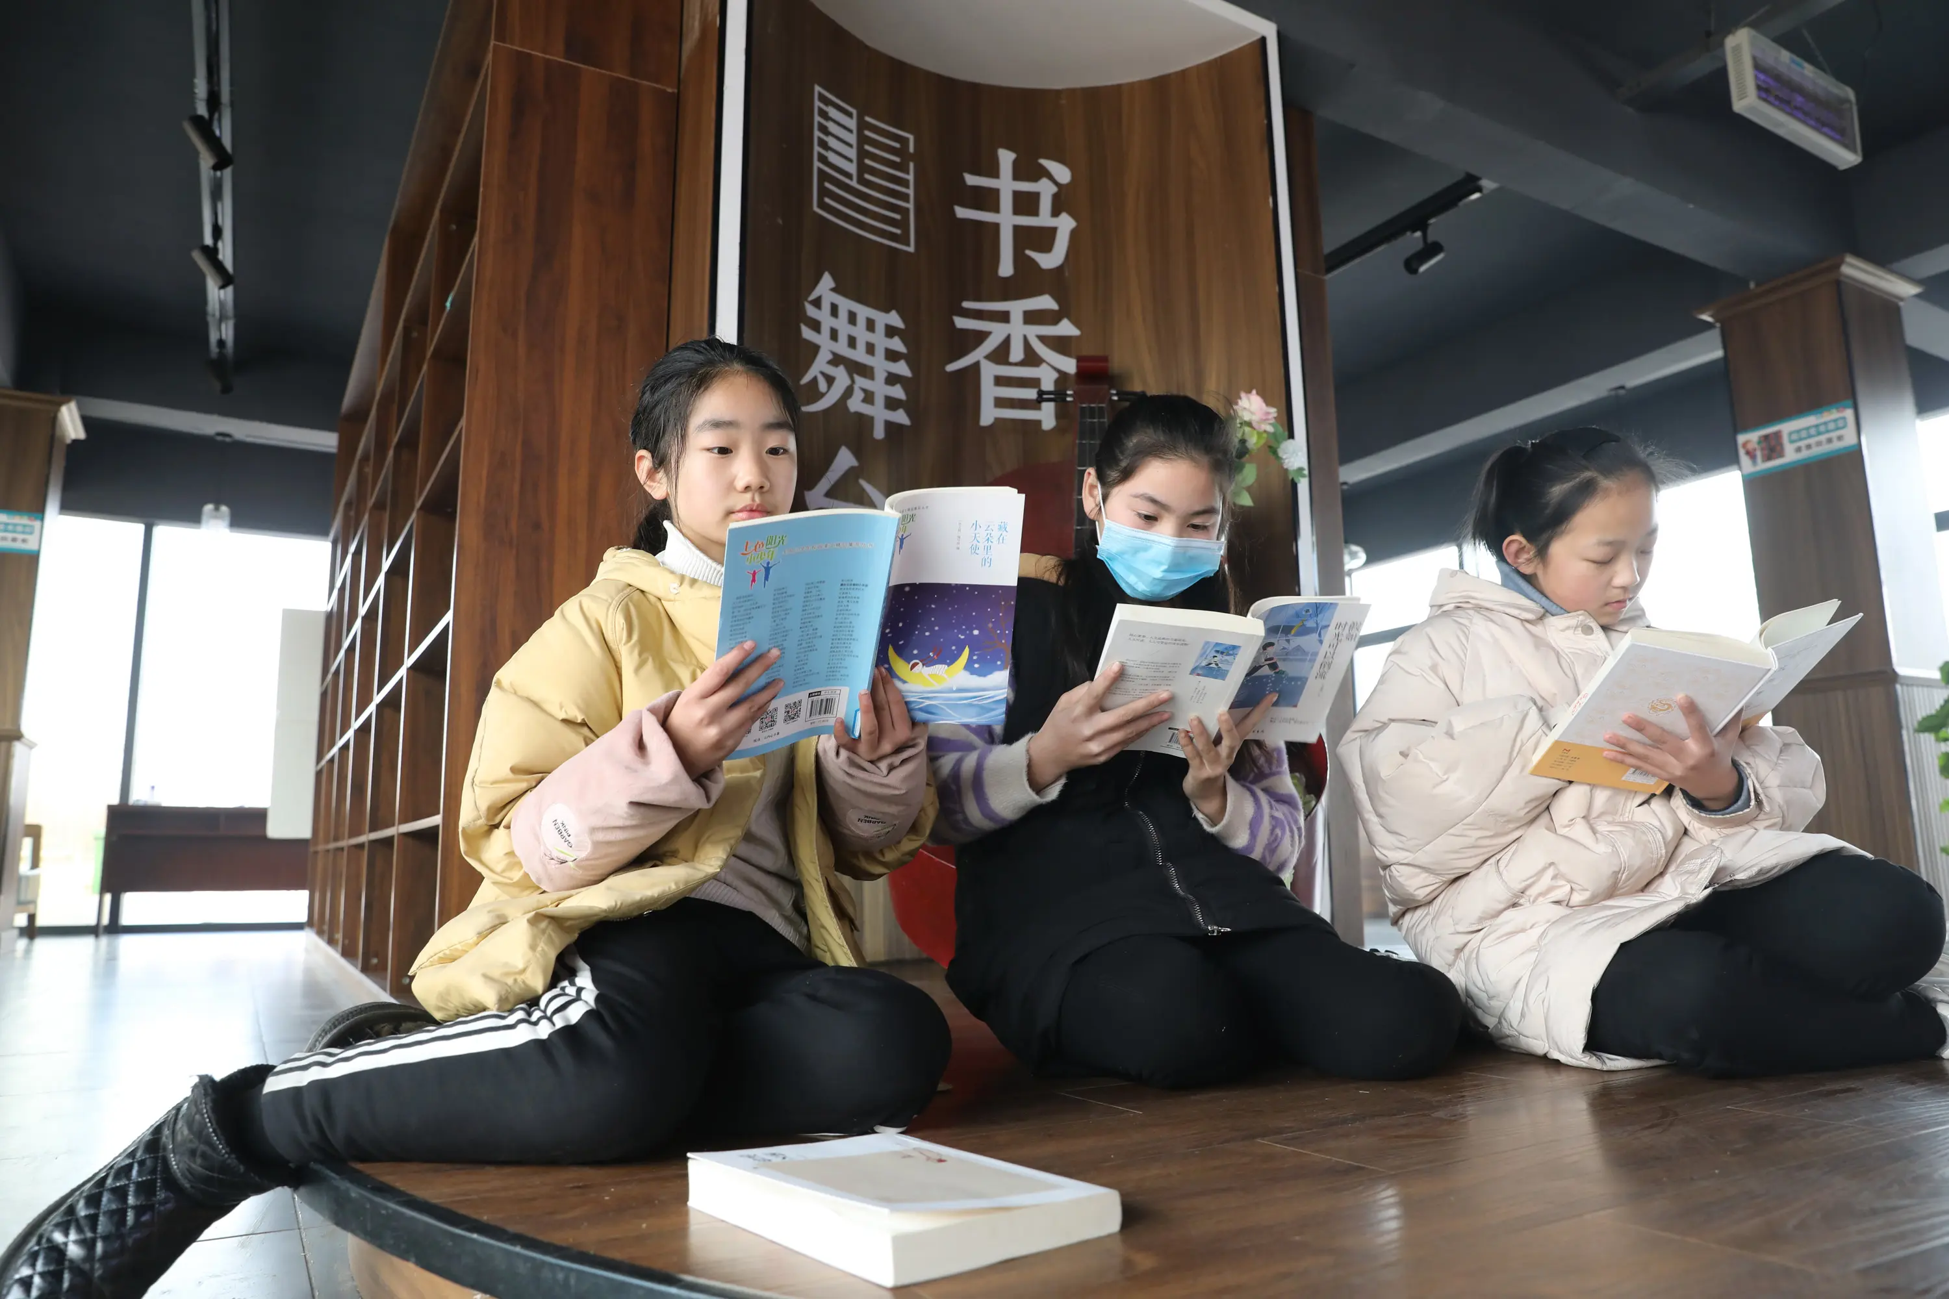
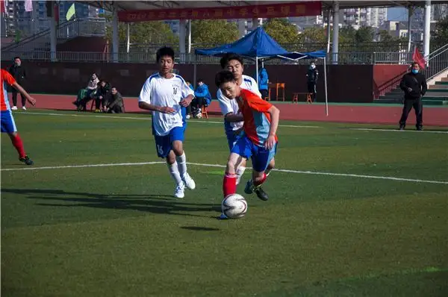
Talk about good habits and bad habits.
They read books every day.
He always exercises.

Slide 52
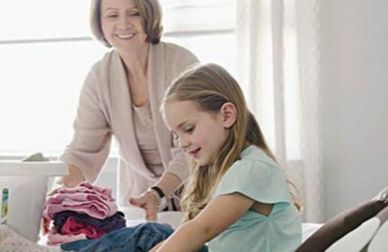
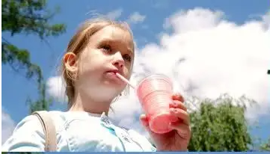
I always help with the housework.
She often drinks juice.

Slide 53
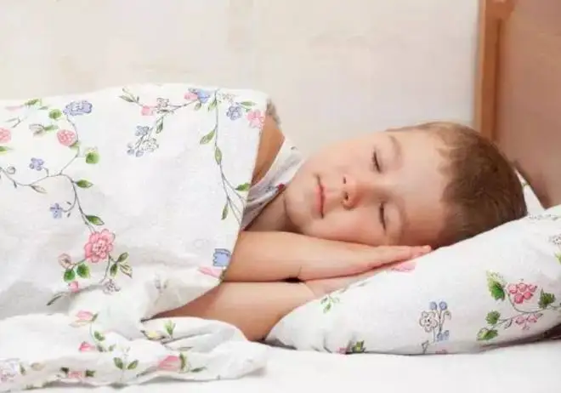
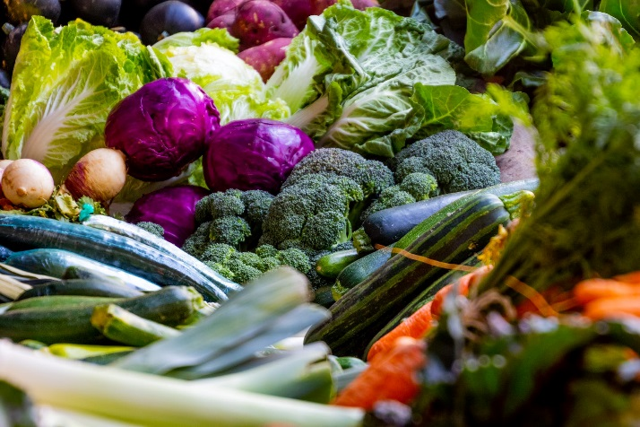
He hardly ever stays up late.
I eat a lot of vegetables every day.

Slide 54
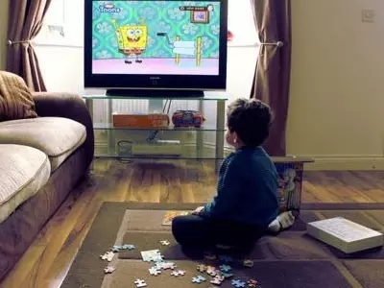
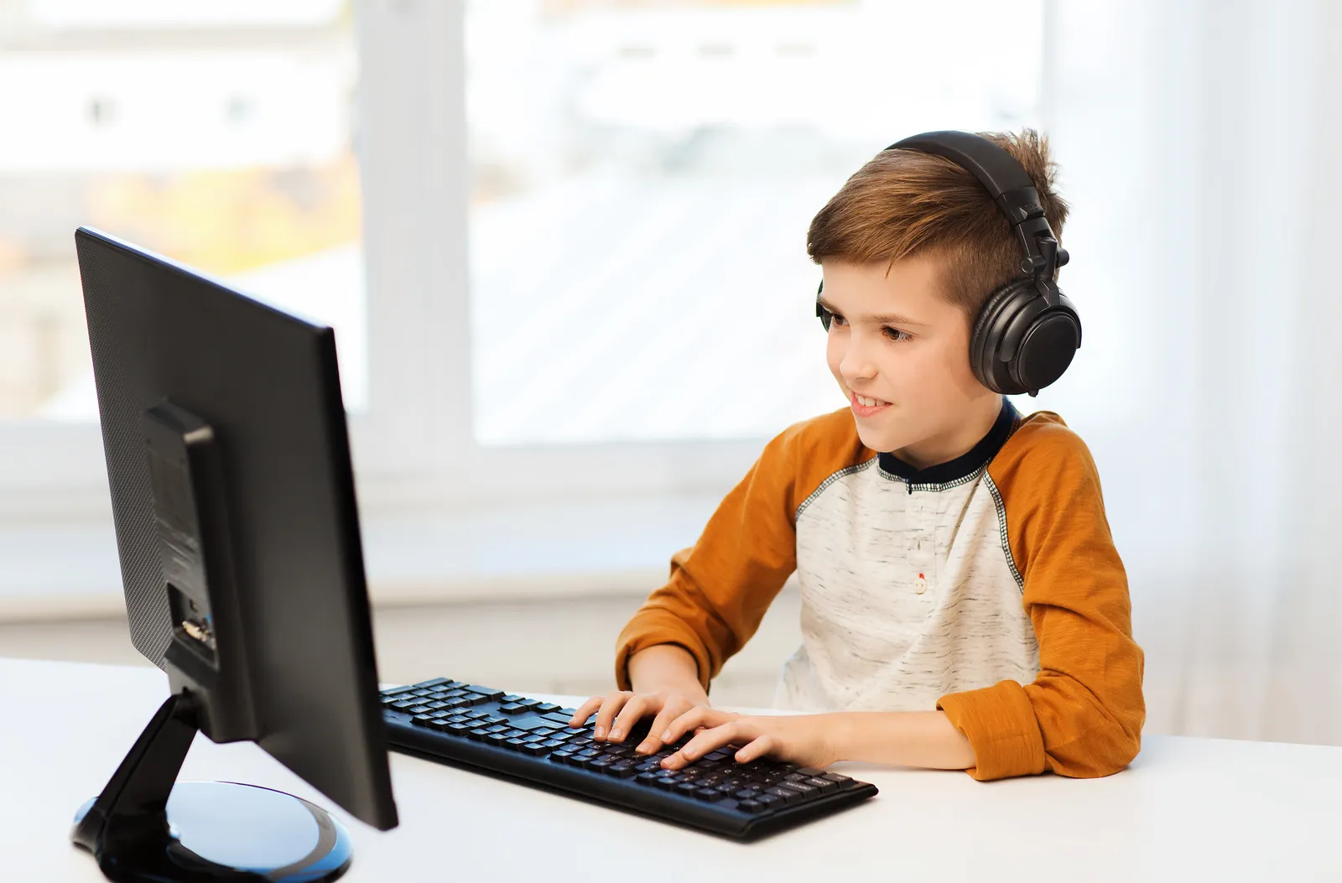
He usually watches TV for over two hours a day.
He often goes online.

Slide 55
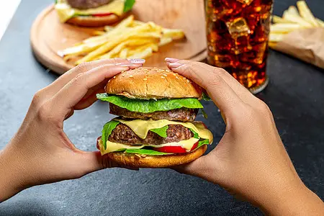
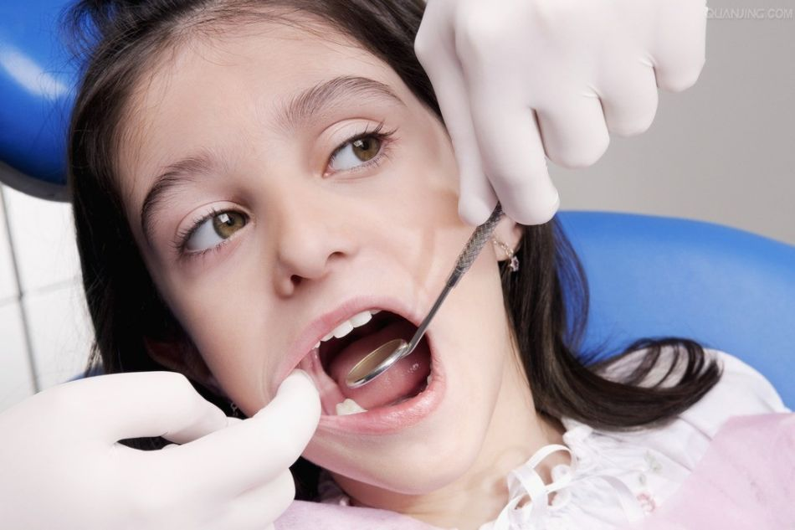
I sometimes eat hamburgers.
She never goes to the dentist.
n. 牙科医生

